Slide 1
Welcome to the Future of Academic Affairs Forum
January 18, 2024

Slide 2
An Overview and Strategic Context
Elizabeth H. Simmons
Executive Vice Chancellor

Slide 3
Strategic Context
UC San Diego’s Strategic Plan asks us to be student-centered, research-focused, and service-oriented to serve the people of California as an inclusive public research university.
Academic Affairs uses a structured collaborative method called Collective Impact to advance the strategic plan, so that our separate efforts will have the maximum impact:
Making our educational innovation a source of pride and excellence
Enhancing the scope and interdisciplinary reach of our scholarship
Enabling every single Triton to reach their full potential

Slide 4
Today’s Purpose
As UC San Diego embarks on a refresh of the strategic plan, we need to contribute our collective wisdom.
And as the largest single unit within the university, Academic Affairs has a lot to contribute. Your ideas will make a difference!
This is the moment to reflect on what we’ve done well in the past ten years – our progress on the goals we have set ourselves and the goals our WASC accreditor set us.
It’s also time to brainstorm about where we can achieve more.

Slide 5
Discussion Topics:
A Service-Oriented Culture Reflects Pride in our Work
Transparency, to help each person find the information they need
Clarity about how each job contributes to the strategic plan
Raising our Research Rankings and Impact Requires Thinking Big
Teaching researchers how to plan and lead larger collaborations
Facilities that support ambitious, interdisciplinary work
Making the Most of Summer Challenges our Imagination
What does summer mean to our students? What could it mean?
What novel audiences could we bring to campus in the summer?

Slide 6
Reflection:
Honest and Purposeful Communication is at the heart of change
If something isn’t working, tell those who can fix it.
If you’ve fixed something, tell those who raised concerns.
True communication is bi-directional… and courageous.
If we keep communicating, there’s no limit to what we can achieve together.
Thank you for being here today to share your ideas about how Academic Affairs can help UC San Diego achieve its aspirations.

Slide 7
Transparency in Academic Personnel Processes
Robert E. Continetti
Sr. Associate Vice Chancellor – Academic Affairs
Distinguished Professor of Chemistry
Notes:
The academic personnel (AP) system of the University of California, with multi-level review of the faculty carried out on a regular basis, is an essential component that supports the excellence of the faculty and makes this one of the leading public institutions of higher education in the world. However, stakeholders at all levels report finding the system complex to use and challenging to administer; addressing these concerns is one of our top priorities.
Coming out of the pandemic, we have focused significant attention on improving the efficiency of operations within Academic Personnel Services, however the AP mission of the university requires transparency and coordination from the level of individual faculty and staff all the way to the Office of the Chancellor. Therefore, in the current academic year we are launching a number of initiatives intended to improve the efficiency of the system, and provide transparency to faculty and staff alike regarding the status of the academic review process.
Here we review specific initiatives focused on improving transparency and efficiency, continued implementation of enterprise systems to support academic personnel processes, and using AI tools to help faculty and staff navigate AP policies and processes. Each initiative is data-driven and incorporates pilot testing so end-user feedback will drive further improvement.

Slide 8
Academic Personnel Initiatives
Transparency Dashboard
Interfolio RPT and Faculty180
Streamlining the Office of Academic Recruitment Services (OARS) Approval Workflow
Kuali Tools to Speed AP Processes:
Administrative Appointments
RTAD Requests
Course Overload Approvals
FSEP/FLS
Entry Level Salary Agreements
Artificial Intelligence in AP and Service Now
Enhanced Training
Notes:
Transparency Dashboard - is intended to serve as a single source of information for faculty to have access to the status of the variety of personnel actions processed by central APS and by School Dean/VC offices.
Interfolio RPT – is an electronic system used to route personnel review files. Importantly, review cases that are fully processed in Interfolio RPT will allow faculty to track the status of their file as it works its way through the approval work-flow using the Transparency Dashboard just mentioned.
Faculty 180 – will allow faculty to generate a biobib for review using Interfolio RPT. Once a Faculty180 data set is in place, adding a new publication, grant, or other activity takes just minutes. Moreover, the data used to generate a BioBib within Faculty180 can also be used to instantly generate customized CV’s, bibliographies, and biosketches including in formats commonly used by granting agencies.
Kuali tools - APS has converted a wide range of paper forms and manual approval routing to a Kuali format. The Kuali tool also allows departmental and school staff, administrators and faculty to track the progress of each submission and its current status in the approval workflow.
AI - APS is exploring the use of AI to augment and support teaching and learning of AP policy and process. Academic Personnel will leverage the recently published Academic Personnel Process Manual as a robust knowledge base to fuel AP AI-driven learning initiatives.
Enhanced Training - APS created a robust training review committee including the Senate CAP Analyst and 19 staff across general campus and the Health Sciences. he top 4 topic areas identified for updating were the Academic Personnel Overview class, Academic Reviews, AP Data training, and Unit 18 training. Current efforts are underway to address these four areas. There are an additional 15 training topic areas that have been identified for updates and/or development.

Slide 9
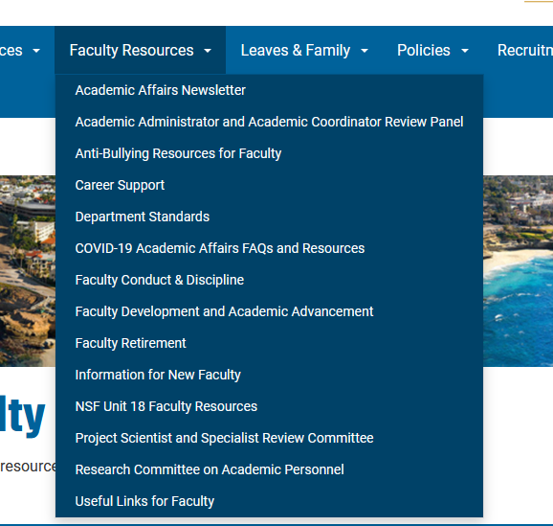
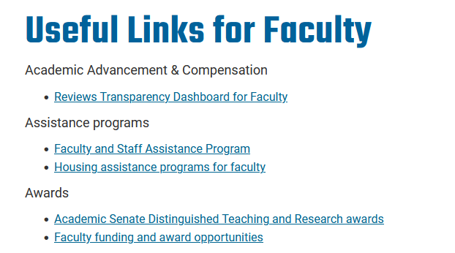
https://aps.ucsd.edu/
Notes:
All resources I’ve mentioned can be found on the Academic Personnel Services webpage at aps.ucsd.edu.
Information for faculty, including the transparency dashboard, can be found by going to the Faculty Resources tab and scrolling down to Useful links for Faculty.

Slide 10
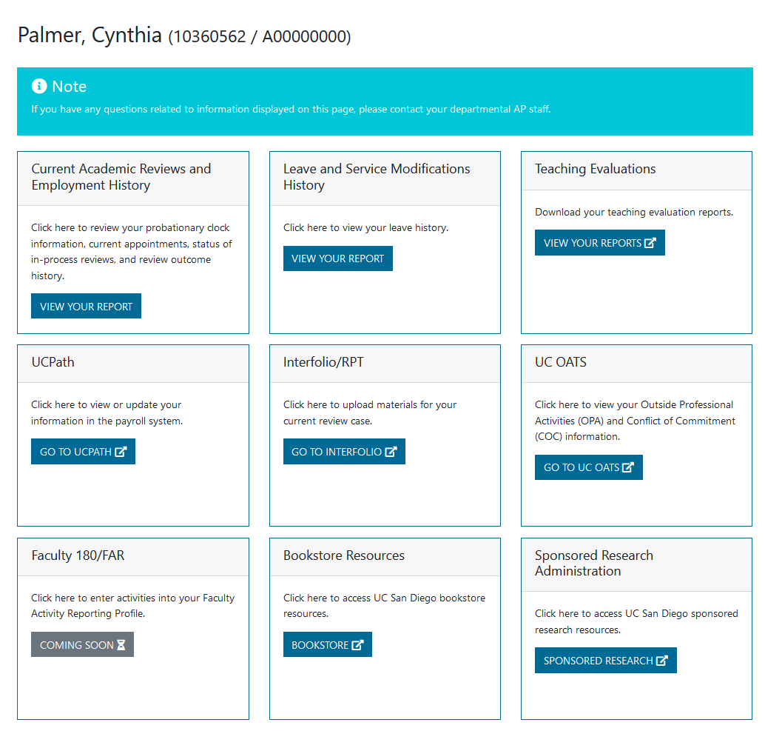
Employee Name / ID
Notes:
The dashboard itself looks like this and includes your name and employee id (most people don’t know their employee id so this is an easy, quick place to find it)
The first box is where you’ll go to review basic information such as rank/step and salary, including any off-scale component. This is also where you’ll go to check the status of an in-progress review, keeping in mind that it will only display status if you’re file is in Interfolio RPT. The earlier in the review process your department uses RPT, the more you’ll be able to track.

Slide 11
How to Reach Us:
Sr. AVC Continetti
savcaa@ucsd.edu
Asst. VC Palmer
c5palmer@ucsd.edu
Notes:
We’re always interested in your comments and feedback - please don’t hesitate to reach out

Slide 12
Discussion Questions:
What other information would it be helpful to have available through the APS transparency dashboards?
What other kinds of transparency dashboards could be helpful?
What other methods or tools can help us be more transparent and service-oriented?
Notes:
Transparency Dashboard - is intended to serve as a single source of information for faculty to have access to the status of the variety of personnel actions processed by central APS and by School Dean/VC offices.
Interfolio RPT – is an electronic system used to route personnel review files. Importantly, review cases that are fully processed in Interfolio RPT will allow faculty to track the status of their file as it works its way through the approval work-flow using the Transparency Dashboard just mentioned.
Faculty 180 – will allow faculty to generate a biobib for review using Interfolio RPT. Once a Faculty180 data set is in place, adding a new publication, grant, or other activity takes just minutes. Moreover, the data used to generate a BioBib within Faculty180 can also be used to instantly generate customized CV’s, bibliographies, and biosketches including in formats commonly used by granting agencies.
Kuali tools - APS has converted a wide range of paper forms and manual approval routing to a Kuali format. The Kuali tool also allows departmental and school staff, administrators and faculty to track the progress of each submission and its current status in the approval workflow.
AI - APS is exploring the use of AI to augment and support teaching and learning of AP policy and process. Academic Personnel will leverage the recently published Academic Personnel Process Manual as a robust knowledge base to fuel AP AI-driven learning initiatives.
Enhanced Training - APS created a robust training review committee including the Senate CAP Analyst and 19 staff across general campus and the Health Sciences. he top 4 topic areas identified for updating were the Academic Personnel Overview class, Academic Reviews, AP Data training, and Unit 18 training. Current efforts are underway to address these four areas. There are an additional 15 training topic areas that have been identified for updates and/or development.

Slide 13
Expanding Summer Academic Offerings
Rocco Fragomeni Director, Summer Planning | Educational Innovation

Slide 14
Summer at UC San Diego
Fall | Winter | Spring
Summer Session 1
Summer Session 2
Special Session (Variable Length)
Plays a major role in student success and academic progress
Many students utilize summer session to:
Start early (before their first fall term); Stay on-track; Get ahead
Financially beneficial
Maximize summer opportunities; remote coursework
Can alleviate stress on physical space and course capacity during the fall, winter, and spring

Slide 15
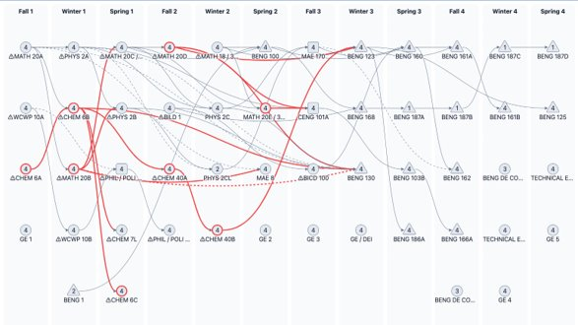
Identifying Student Needs
Educational Innovation is working to improve our collective approach to identifying high priority courses to remove barriers to student success
Working on adding: DFW, waitlist, and cadence to degree plans
Subject to constant change
Welcome feedback for improvement

Slide 16
Discussion Group Questions
How does your department strategize summer course offerings?
What can we add to Educational Innovation’s analysis? (Currently we account for DFW, Waitlist, cadence, and complexity of sequences/prerequisites)
What barriers do you or does your department have to offering summer courses?
What are the barriers for students who aren’t currently participating in Summer Session or other summer programs?
In addition to listing high priority courses, are there any trends that we can address through existing or new summer programs?

Slide 17
WSCUC Review
Preparing for reaffirmation of accreditation
John Moore
Dean of Undergraduate Education

Slide 18
WHAT IS WSCUC AND ACCREDITATION?
The University of California, San Diego is accredited by WASC Senior College and University Commission (WSCUC), the regional accrediting agency serving higher education institutions in California, Hawaii, and the Pacific Region.
Accreditation aids institutions in developing and sustaining effective educational programs and assures the educational community and the general public that an accredited institution has met high standards of quality and effectiveness.
Accreditation by a nationally recognized agency is required for students to receive federal student aid from the U.S. Department of Education.

Slide 19
ACCREDITATION CYCLE
A campus self-study and Institutional Report (February 12, 2019)
An off-site Review by WSCUC Review Team (April 23, 2019)
The WSCUC Review Team’s campus visit (November 20-23, 2019)
WSCUC meeting and decision (February 14, 2020)
Reaffirmation of Accreditation Letter (February 26, 2020)
Interim Report (November 1, 2024)
Campus self-study and Institutional Report (February, 2029)
An off-site Review by WSCUC Review Team (Spring, 2029)
The WSCUC Review Team’s campus visit (Fall, 2029)

Slide 20
2020 OUTCOMES
Reaffirmation of accreditation for 10 years (maximum term)
Six commendations
Eight areas to address
Interim report (due November 2024)

Slide 21
COMMENDATIONS
Quality of institutional self-study – thorough and self-reflective
Creation of the Teaching + Learning Commons
Senior leadership: common vison, focused on student success, collaborative, and creative
Campus financial management, including budget and resource allocation: bold, successful, and transparent
Strengthening ties between the campus and the community (e.g. trolley); note: Eighth College’s community-engaged curriculum had not yet been developed
An atypical visionary mode of planning, with a proactive focus on the future

Slide 22
AREAS TO ADDRESS
Continue to improve graduation rates: (i) achieve 75% 4-year rates by 2030 and (ii) eliminate equity gaps
75% already achieved – working towards 85%
Collective Impact approach to addressing equity gaps; several initiatives underway
Continue work on assessment for educational effectiveness; integrate with program reviews
Assessment meetings with academic units, assessing and addressing equity gaps now part of the charge for program reviews

Slide 23
AREAS TO ADDRESS – continued
Assess the many diversity and student success programs
Assessment in Student Retention & Success, the Commons (e.g., Summer Bridge, Supplemental Instruction
Resist pressure to increase enrollment targets (allowing for modest growth)
We are already at our 2030 undergraduate target (32K)
New enrollment management strategies
Ongoing discussion with UCOP

Slide 24
AREAS TO ADDRESS – continued
Diversify non-resident undergraduate enrollment (then at 23%); more international diversity and increased domestic non-resident enrollment
We have increased domestic non-resident enrollments and, to some extent, are attracting international students from more diverse countries
Under the compact with the governor, we will be reducing non-resident enrollments to 18%
Increase essential student life and academic program resources (e.g., health (including mental health), OSD, Advising, and Tas
Recently increases in student health (CAPS, Case Managers), OSD, advising, faculty FTEs
The new TA contract may have ramifications on TA staffing

Slide 25
AREAS TO ADDRESS – continued
Act on the recommendations of the Holistic Teaching Evaluation workgroup
Implementation committee, followed by a standing committee
New SETs have been implemented
Standing committee is working to phase in portfolio review
Address capped major issue
Three committees
The Academic Senate recently endorsed modified procedures
Better addresses diversity and equity in high-demand majors
The Senate-Administration Workgroup on the WSCUC Interim Report will investigate progress and draft the report by May 1.

Slide 26
DISCUSSION QUESTIONS
What successes do we want to highlight in our interim report and WSCUC review?
What challenges should we discuss?
How can your units work to address any of the eight areas identified in the Commission letter?

Slide 27
UC San Diego Research: Global Research & Innovation Powerhouse
Corinne Peek-Asa, PhD
Vice Chancellor for Research and Innovation

Slide 28
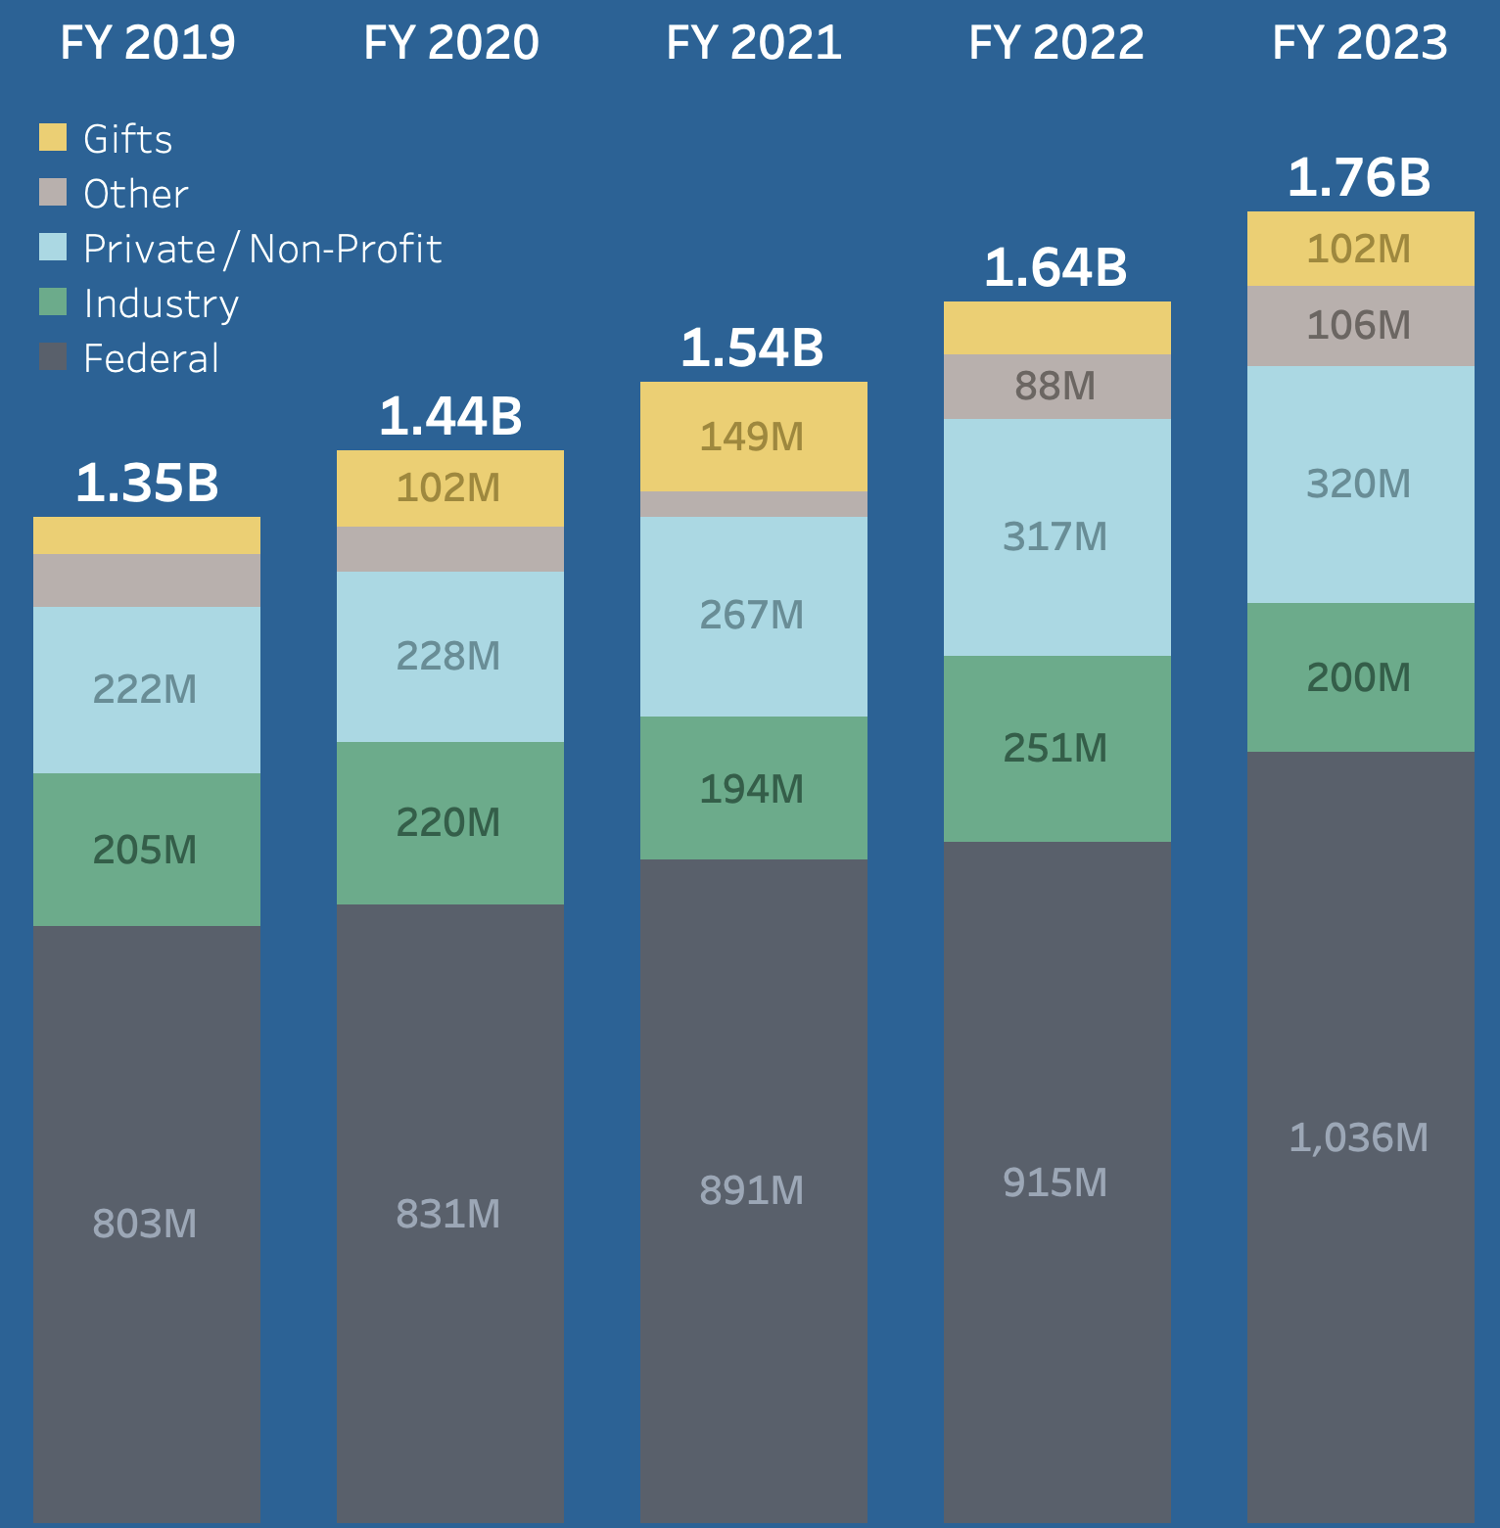
$1.76B
In Sponsored Research

Slide 29
UC San Diego is ranked…
7th | Clarivate Highly Cited Researchers The 2023 Highly Cited Researchers list includes 71 faculty distinctions from UC San Diego - the highest number of influential voices in the UC system and ranks 7th highest among universities worldwide.
3rd | AUTM: Academic Innovation AUTM, the leading organization tracking tech transfer, ranks UC San Diego as 3rd in the nation for innovation and start-ups.
20th | U.S. News and World Report UC San Diego ranked 20th in Best Global Universities rankings, and ranked 7th based on 13 indicators, including global and regional research reputation, international collaboration and total citations.
7th | HERD Survey of Federal Research Expenditure UC San Diego ranked 7th among all Universities in federal research expenditures and ranked 5th among our peer group (1st among the UCs).
29

Slide 30
UC San Diego is poised to increase our reputation as international thought leaders in the most important areas of research, discovery, and innovation.
We will be successful by doing the right work, in the right way
(and not by always having to do more work).

Slide 31
Strategic Refresh: Four Grand Research Themes
Understanding and protecting the planet
Enriching human life & society
Exploring the basis of human knowledge, learning and creativity
Understanding cultures and addressing disparities in society
31
Notes:
Photograph of Jia Shen is a clinician educator at the UC San Diego School of Medicine physician mentor for the International Health Collective and medical director at UC San Diego’s outpatient clinic in Bankers Hill
Focus on four multidisciplinary areas where our campus has deep and broad expertise and that are rich with possibility for creation and innovation, education, and training.

Slide 32
Discussion Questions:
From the perspective of your disciplinary strengths as a department and considering relevant interdisciplinary networks, what is one priority area for future research, discovery, and innovation that is poised for growth and impact?
What are the key resources needed to support growth in this area?
What is a strategic activity that can begin to generate this growth?

Slide 33
Breakout Sessions
Transparency Summer Research WASC
Please return to the main session at 10:45

Slide 34
Report Out
Transparency Summer Research WASC

Slide 35
Transparency Discussion Questions:
What other information would it be helpful to have available through the APS transparency dashboards?
What other kinds of transparency dashboards could be helpful?
What other methods or tools can help us be more transparent and service-oriented?
Notes:
Transparency Dashboard - is intended to serve as a single source of information for faculty to have access to the status of the variety of personnel actions processed by central APS and by School Dean/VC offices.
Interfolio RPT – is an electronic system used to route personnel review files. Importantly, review cases that are fully processed in Interfolio RPT will allow faculty to track the status of their file as it works its way through the approval work-flow using the Transparency Dashboard just mentioned.
Faculty 180 – will allow faculty to generate a biobib for review using Interfolio RPT. Once a Faculty180 data set is in place, adding a new publication, grant, or other activity takes just minutes. Moreover, the data used to generate a BioBib within Faculty180 can also be used to instantly generate customized CV’s, bibliographies, and biosketches including in formats commonly used by granting agencies.
Kuali tools - APS has converted a wide range of paper forms and manual approval routing to a Kuali format. The Kuali tool also allows departmental and school staff, administrators and faculty to track the progress of each submission and its current status in the approval workflow.
AI - APS is exploring the use of AI to augment and support teaching and learning of AP policy and process. Academic Personnel will leverage the recently published Academic Personnel Process Manual as a robust knowledge base to fuel AP AI-driven learning initiatives.
Enhanced Training - APS created a robust training review committee including the Senate CAP Analyst and 19 staff across general campus and the Health Sciences. he top 4 topic areas identified for updating were the Academic Personnel Overview class, Academic Reviews, AP Data training, and Unit 18 training. Current efforts are underway to address these four areas. There are an additional 15 training topic areas that have been identified for updates and/or development.

Slide 36
Transparent, Service-Oriented Administrative Culture
Efficiency dashboards are useful in transactional processes
Be intentional about what kinds of transparency are required
Provide context for the information
Extending to administrative dashboards for recruitment processes

Slide 37
Summer Discussion Questions:
How does your department strategize summer course offerings?
What can we add to Educational Innovation’s analysis? (Currently we account for DFW, Waitlist, cadence, and complexity of sequences/prerequisites)
What barriers do you or does your department have to offering summer courses?
What are the barriers for students who aren’t currently participating in Summer Session or other summer programs?
In addition to listing high priority courses, are there any trends that we can address through existing or new summer programs?

Slide 38
Expanding Our Summer Offerings
Priorities for offering courses: Faculty availability
Setting up Summer similar to other quarters - many opportunities available in addition to summer courses
Flexibility to capture the many opportunities already on campus and making them available to everyone (grad, undergrad, non credit, internships, etc)
Barriers: financial aid, housing availability, opportunity cost of not working/internship
What are the barriers for students to take summer courses and faculty to teach summer courses? Students need access to affordable housing, employment opportunities, transportation to school
Faculty or departments might not be incentivized by money; they value their time and worry about their courses moving to a summer program
Can we make summer courses more of a community? Cohorts of students or faculty working/ learning/ living together and familiarizing with UCSD

Slide 39
Research Discussion Questions:
From the perspective of your disciplinary strengths as a department and considering relevant interdisciplinary networks, what is one priority area for future research, discovery, and innovation that is poised for growth and impact?
What are the key resources needed to support growth in this area?
What is a strategic activity that can begin to generate this growth?

Slide 40
Identifying Our Research Strengths & Investing to Boost Rankings and Impact
Build diverse communities that incentivize research
Provide administrative foundations to sustain research
Spark innovation that helps translate theoretical research to application
How do you think about commercialization - staffing, seed funding and infrastructure support
Look at advances in AI to shape all of research and research administration
Look at use-inspired research generally, could be facilitated by AI

Slide 41
WASC Discussion Questions:
What successes do we want to highlight in our interim report and WSCUC review?
What challenges should we discuss?
How can your units work to address any of the eight areas identified in the Commission letter?

Slide 42
Preparing for our 2024 WSCUC Accreditation Mid-Point Report
What successes do we want to highlight in our interim report and WSCUC review?
Closing the graduation gap - we are close to our goal
Selective Majors: Revised system for continuing students
Holistic Teaching Evaluation - new student evaluations and new faculty portfolios
Collective Impact working to identify metrics
Challenges:
Equity gaps are where we need to spend our time assessing
Increasing the amount of TAs on campus
How do we get faculty to address assessment and anti-racist pedagogy in their profiles?
How can your units work to address any of the eight areas identified in the Commission letter?
The collective impact initiative provides a framework for addressing all areas
Providing more support for program assessment
Standardizing the process for continuing student admission to select capped major

Slide 43
Thank you for attending the Future of Academic Affairs Forum!
A survey and compiled report of the discussion group conversations will be sent to all participants

